Slide 1

Workshop Blazor & ABP
Creating an Event/Meetup Application
https://github.com/hikalkan/presentations

Slide 2
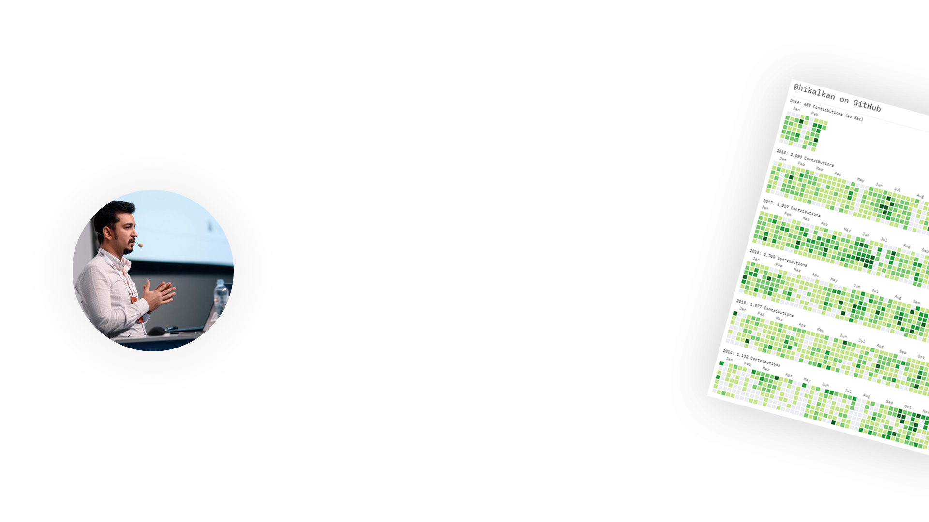
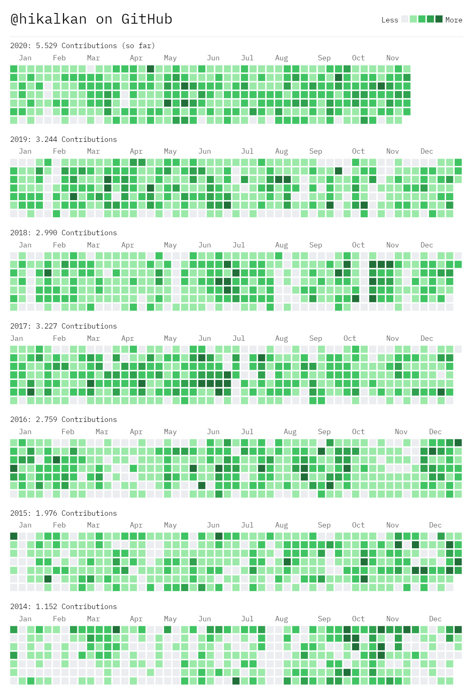

ABOUT ME Halil İbrahim Kalkan
Co-Founder of
Web: halilibrahimkalkan.com
Github: @hikalkan
Twitter: @hibrahimkalkan

Slide 3
What is Blazor?
…

Slide 4
What is the ABP Framework?
…

Slide 5
The Application / Tooling
Tooling
.NET 5.0 & ASP.NET Core 5.0 as the base framework
ABP Framework as the application framework
Blazor as the UI framework
MongoDB as the database provider
Blazorise as a component library

Slide 6
The Application / Event List (Home Page)

Slide 7
The Application / Event Detail

Slide 8
The Application / Create Event

